Slide 1
NHL Player Salary Machine Learning Model
Contributors: John Gaffney, Kazuki Takehaski, Patrick Thornquist

Slide 2

Core Message
Our goal is to use machine learning to determine which NHL contracts are under and overvalued.
We can then use this data to guide us with setting a lineup in Daily Fantasy sports, in the hopes of gaining an edge on competition to earn more gambling profits.

Slide 3
Model Summary
Supervised / Regression
Unsupervised
Linear Regression
Lasso
Huber Regression
Decision Tree Regressor
Neural network
K-Means / Clustering

Slide 4
Data Cleanup & Model Training

Slide 5
Data Collection & Cleanup
We used hockey-reference.com to source our data. This site allowed us to download two CSV files, one with statistics for all players in the 2021-22 season and the other with contract data.
The next step was to join these two CSV files together using an outer join. With under 1000 players to collect data from, we didn’t want to limit our dataset too much.
After completing the join, we still needed to manually correct or update several rows, however, the majority were of the information was joined correctly. We also manually removed goalies from this dataframe.

Slide 6

Problems with Cleanup
Some names were “First Last”, some were “Last, First”. Our code corrected most, but not all.
Slight name differences between the 2 CSV files…”Zach vs. Zachary”, “Matt vs Matthew”, etc.
Nicknames
Foreign names…Teuvo Teräväinen. The extra grammatical features were not picked up, confusing the join.

Slide 7
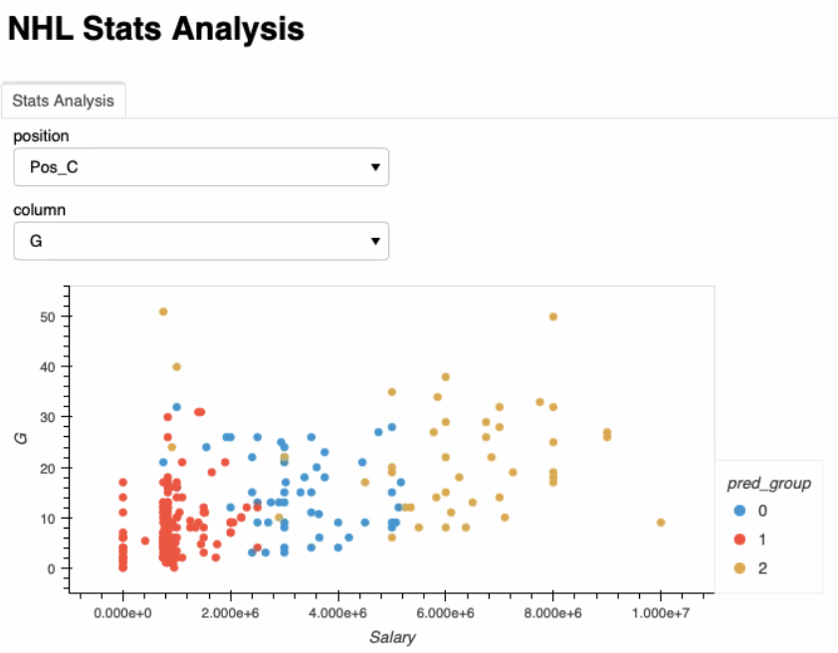
The Dataset
Our finished dataset included information for 875 players.
We used clustering to help visualize the data. We first split up the players by position, then used a K-means model to sort them into 3 groups.

Slide 8
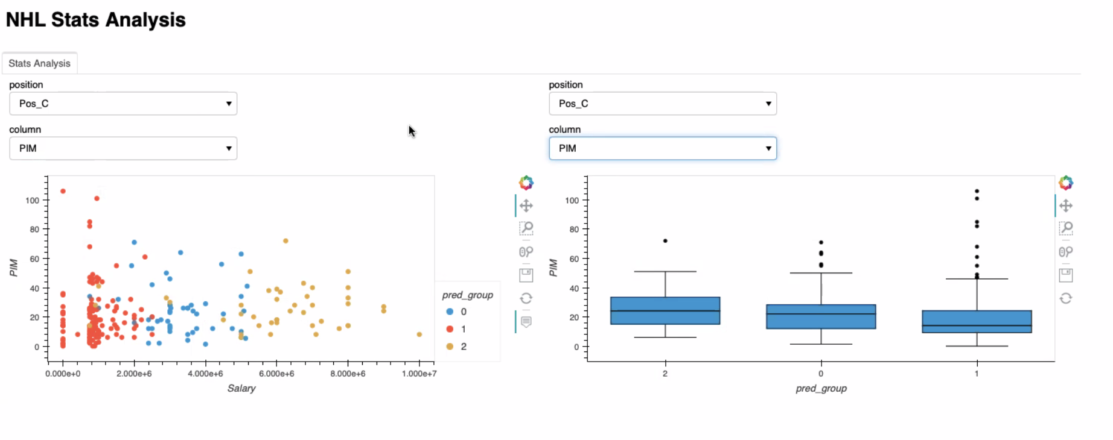
Clustering

Slide 9
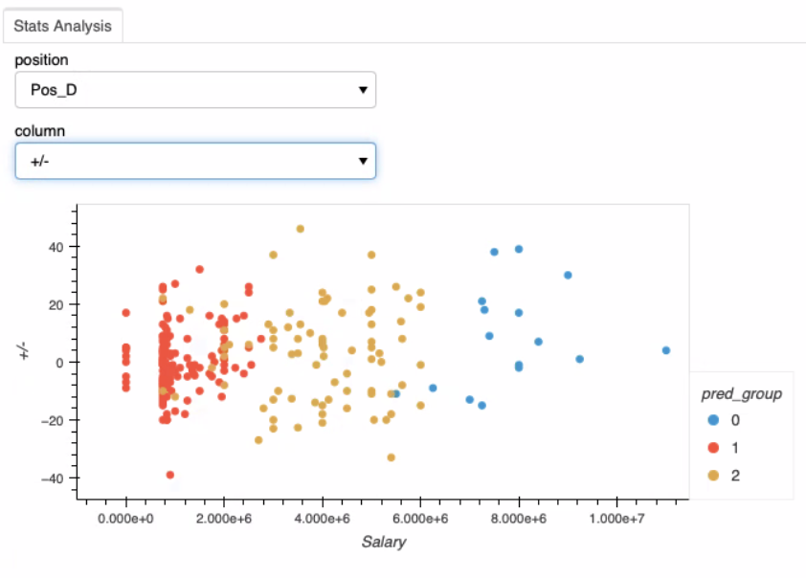

Slide 10
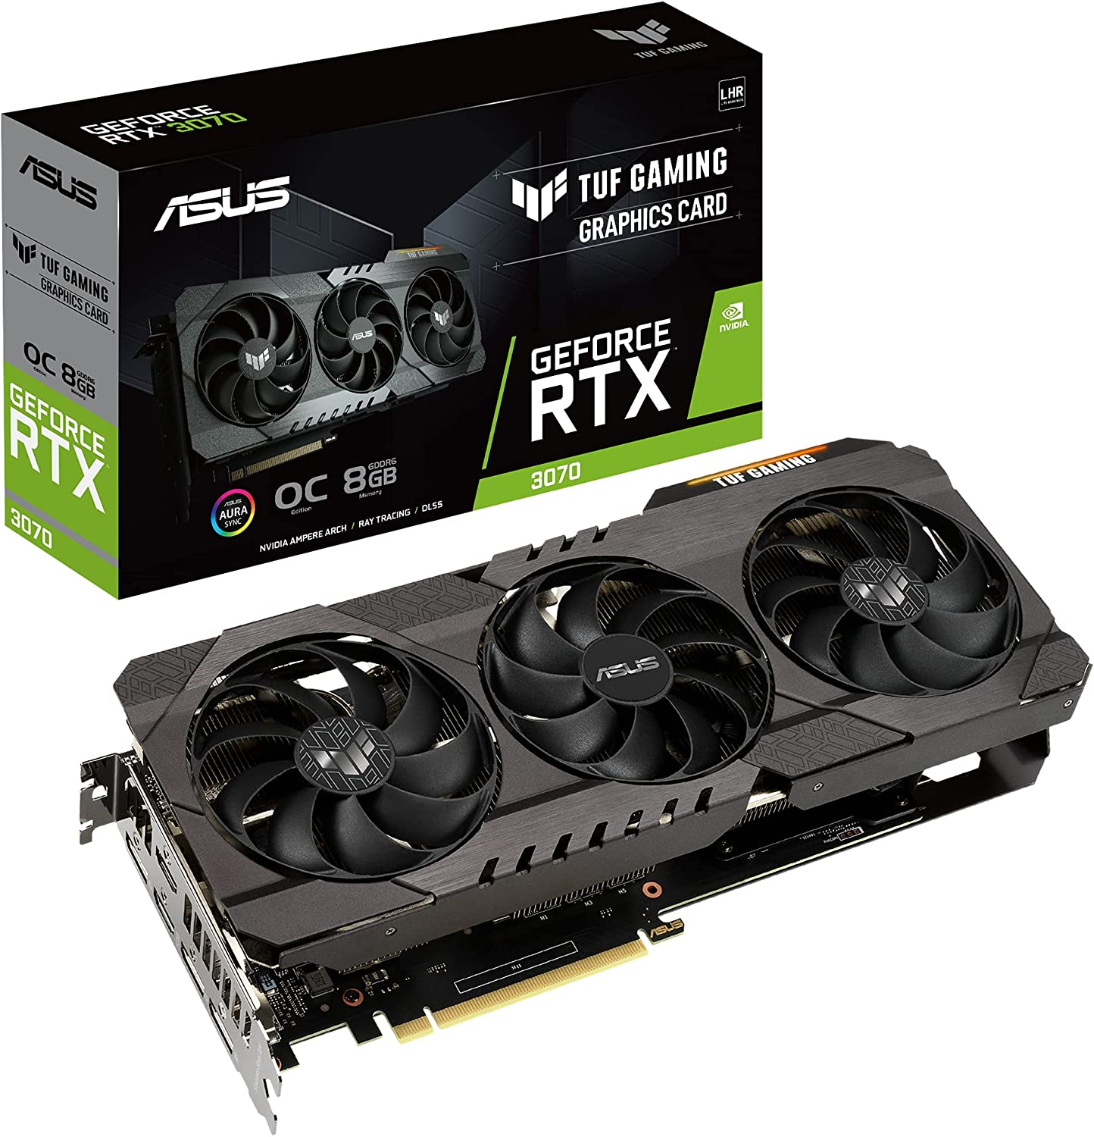
Model Training Process
We trained using a variety of models, which allowed us to compare results to determine which would be the best.
We also tinkered with the variables, changing the number of nodes and hidden layers to examine the differences.
Luckily, John was running a GPU (GEFORCE RTX 3070), which significantly sped up the model training process.

Slide 11

Problems with Model Training
At first, we were treating regression models like classification models. This led to empty values and always returned a loss of 1.
Preparing the features model was difficult. It required more imports, not all of which worked as expected.
Once we got the features model working, it should be noted that dropping certain features improved the accuracy of the model.

Slide 12
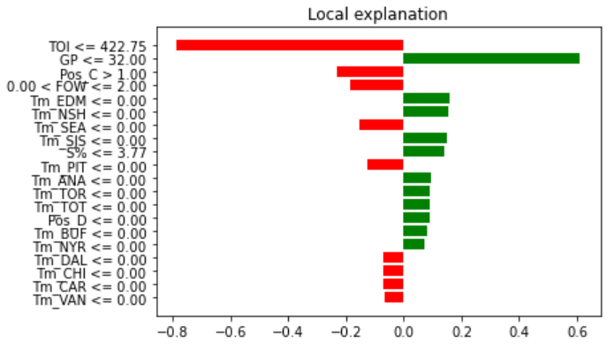
Features importance

Slide 13
Model Evaluation

Slide 14
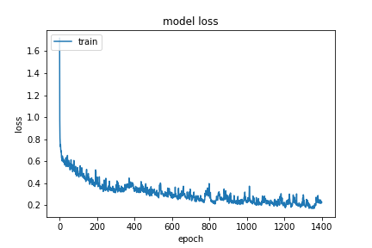
Evaluation Techniques
The most important number we examined was the means squared error, which is the loss function.

Slide 15
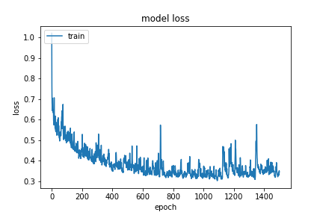
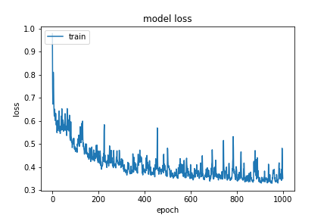
800 neurons

Slide 16
Results (table of all results)
Linear Regression Solver | Mean Square Error
Linear Regression | 0.35
Lasso | 0..32
Decision Tree Regressor | 0.88
Huber Regressor | 0.40
Best Neural Network | 0.25

Slide 17
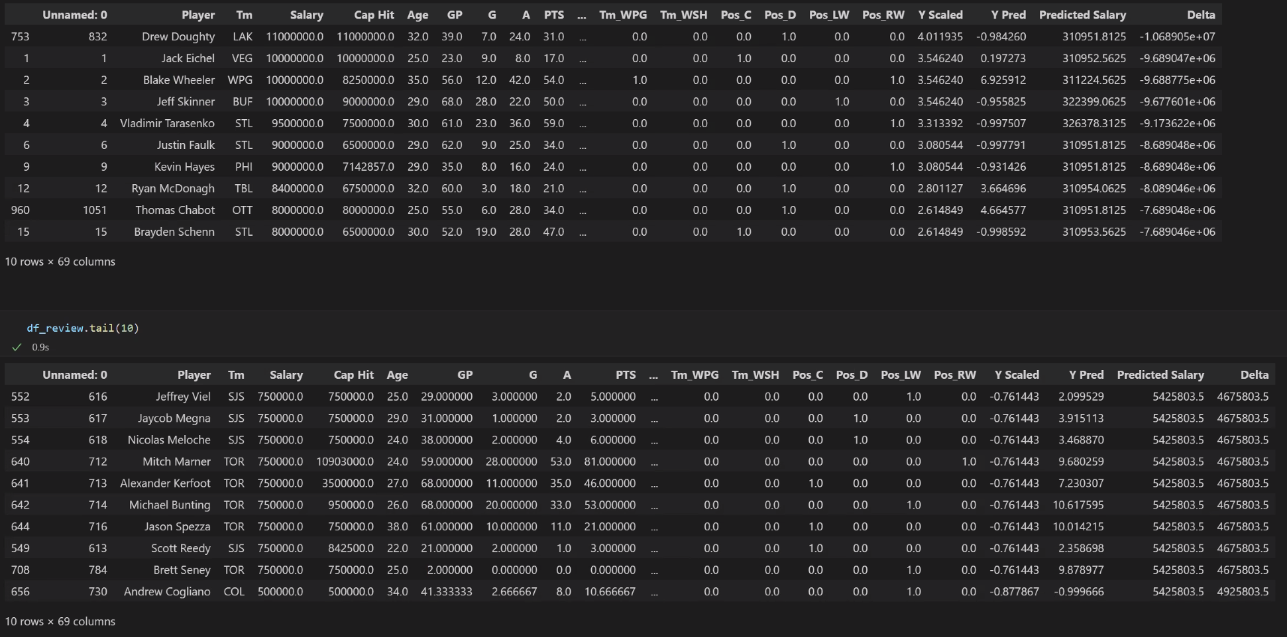
Conclusions
The data behaves nonlinearly so the limited regression models have decreased accuracy.
The neural networks worked better for analyzing this specific data.

Slide 18
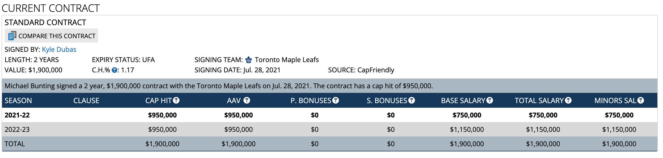

The good…
Michael Bunting

Slide 19
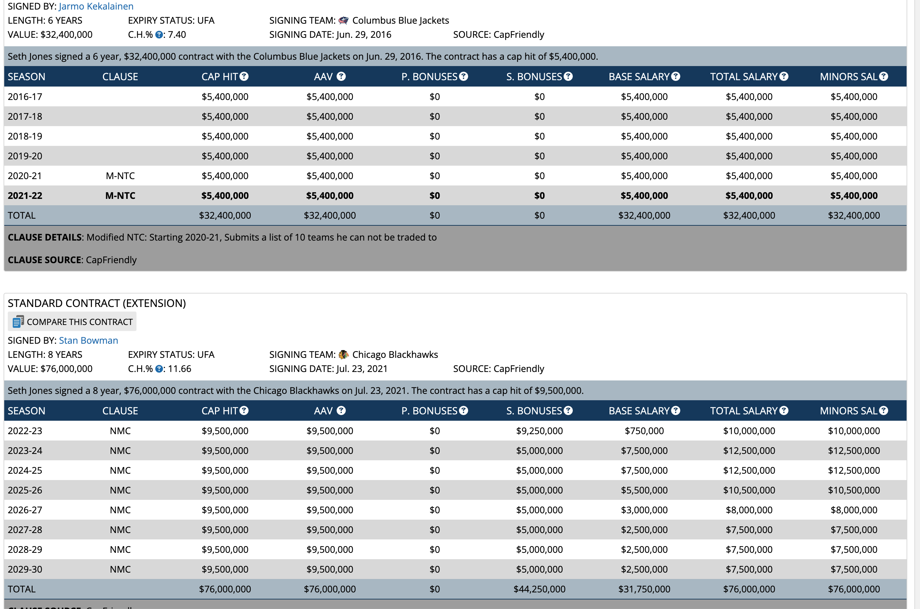


The bad…
Seth Jones

Slide 20

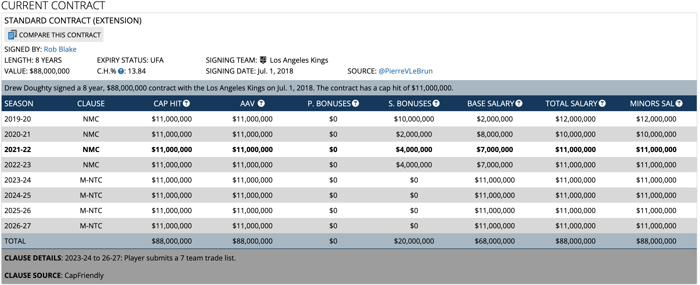

The ugly…
Drew Doughty

Slide 21
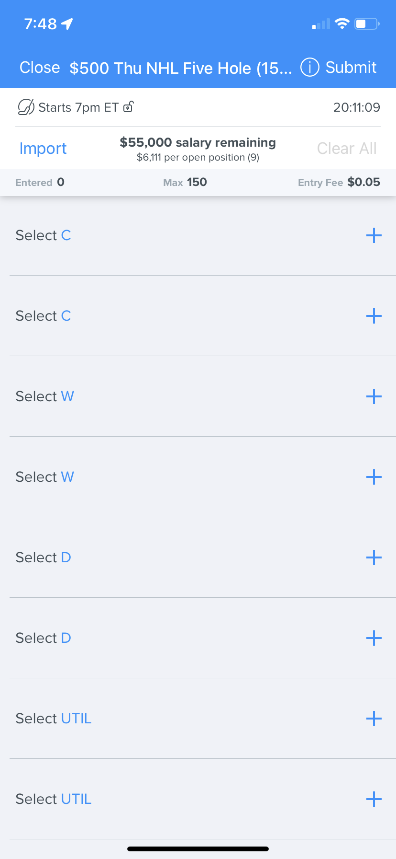
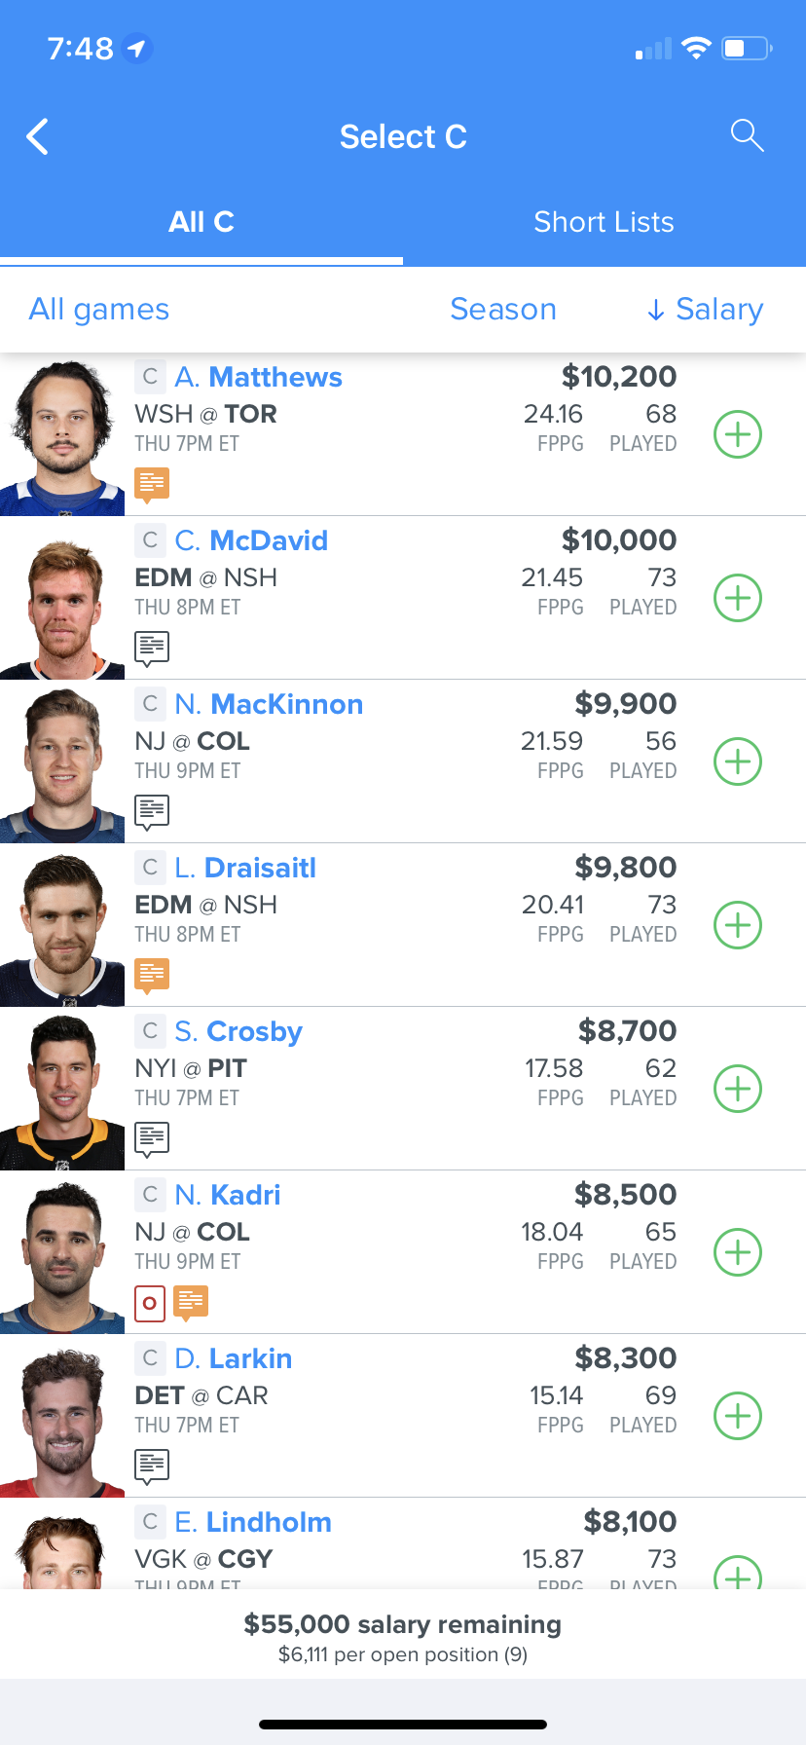
Next steps…
If we had more time, our next steps would include finding a way to get real-time data from the different daily fantasy sports sites on current players salaries.
We would then develop an algorithm to compare these salaries to what our model predicts. This would allow us to decide which players are under or over valued.
Finally, we would use this for real world betting.

Slide 22
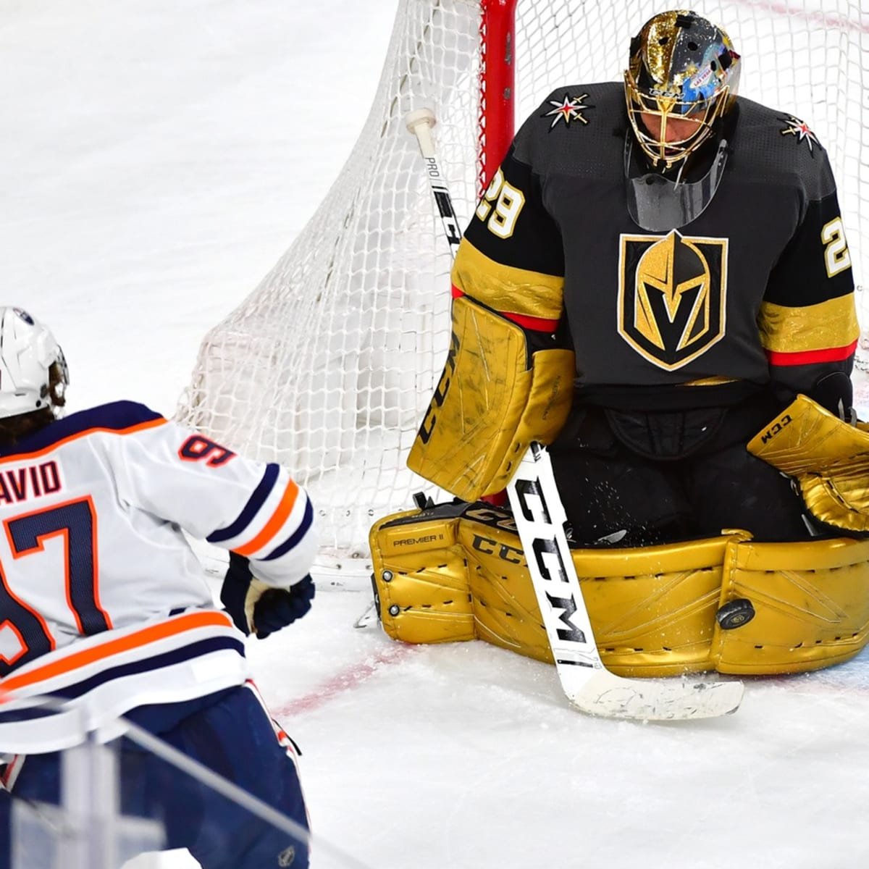
Next steps…
Run a model for goalies, as we only analyzed skaters (forwards and defensemen).
This model would behave differently, as there are different statistics and measurements used.
We would also like to add more data from past seasons.
The last step is to put this model into a dashboard with a player input.

Slide 23

Q & A

